Slide 1
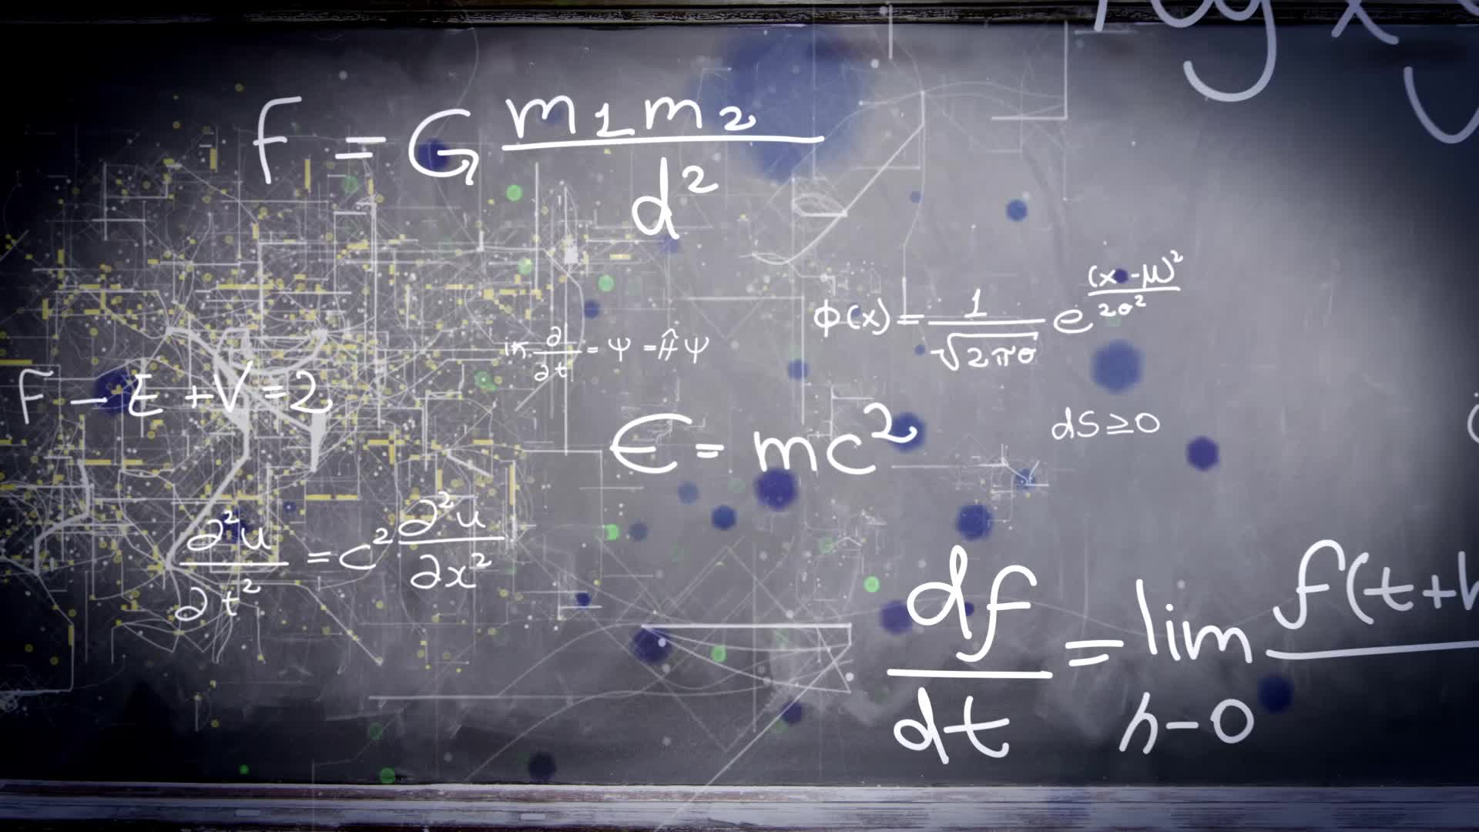
Chapter 2.6:
Related Rates
HONORS CALCULUS/CALCULUS

Slide 2





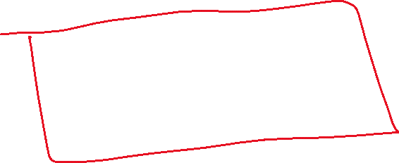



Related rate problems are differentiated with respect to time. This means every variable, except t is a differentiated implicitly.
Ex.) Given $y=x^{2}+3$, find $\frac{dy}{dt}$ when $x=1$, given that $\frac{dx}{dt}=2$.

Slide 3
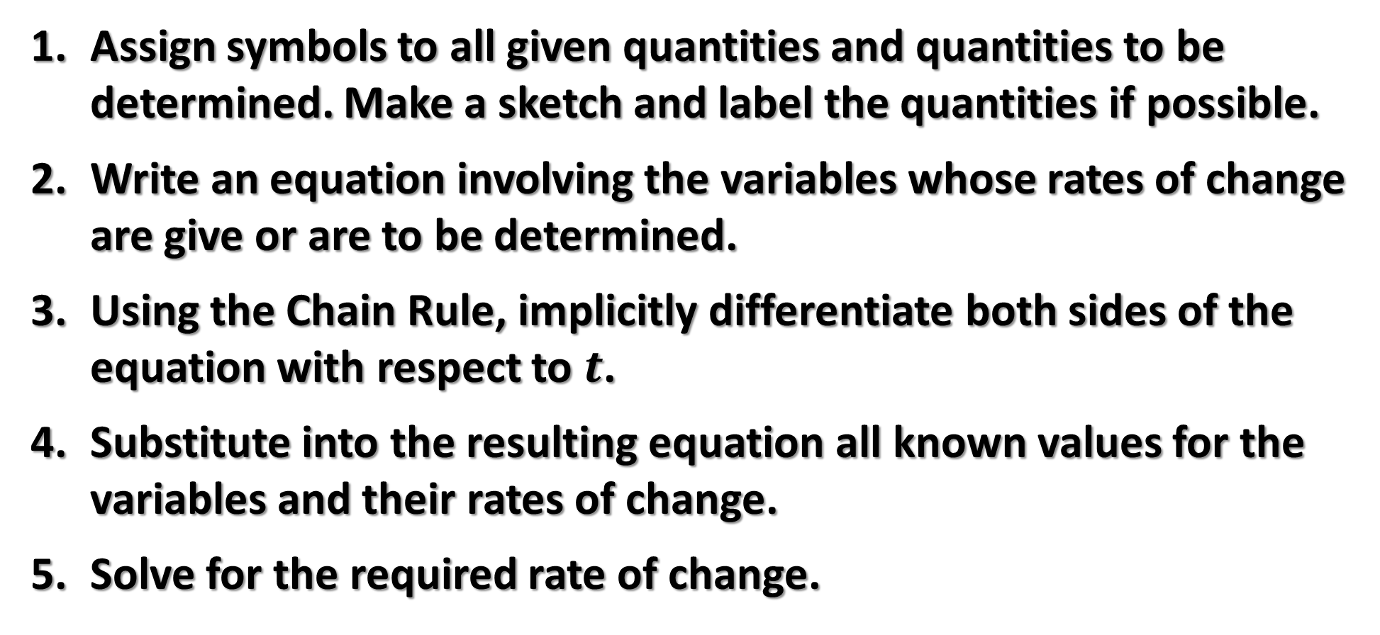
Related Rate Problems
Assign symbols to all given quantities and quantities to be determined. Make a sketch and label the quantities if possible.
Write an equation involving the variables whose rates of change are give or are to be determined.
Using the Chain Rule, implicitly differentiate both sides of the equation with respect to $t$.
Substitute into the resulting equation all known values for the variables and their rates of change.
Solve for the required rate of change.

Slide 4
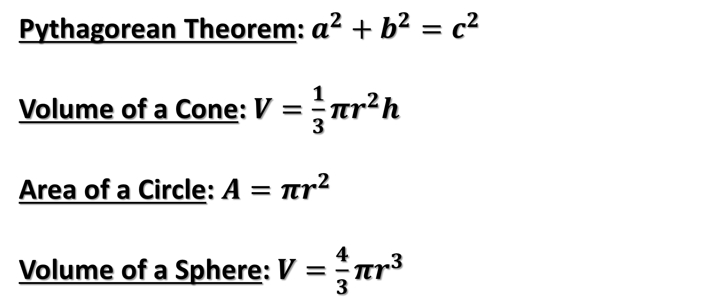
Frequently Used Formulas
Pythagorean Theorem: $a^{2}+b^{2}=c^{2}$
Volume of a Cone: $V=\frac{1}{3}πr^{2}h$
Area of a Circle: $A=πr^{2}$
Volume of a Sphere: $V=\frac{4}{3}πr^{3}$

Slide 5







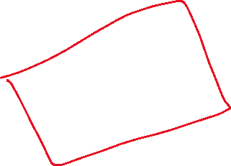
















Ex.) A pebble is dropped into a calm pond, causing ripples in the form of concentric circles. The radius r of the outer ripple is increasing at a constant rate of 1 foot per second. When the radius is 4ft., what rate is the total area A of the disturbed water increasing?

Slide 6


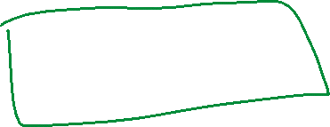


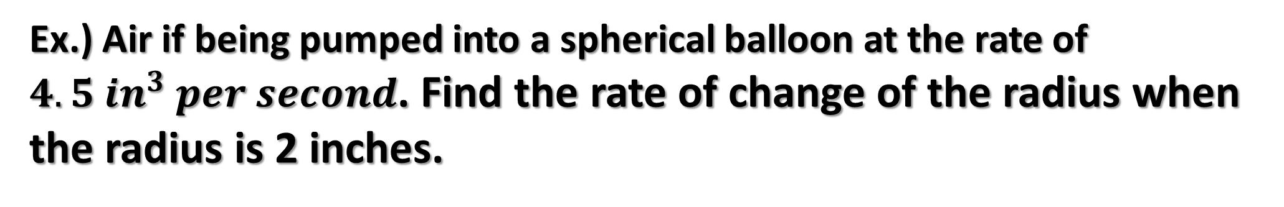

















Ex.) Air if being pumped into a spherical balloon at the rate of $4.5 in^{3} per second$. Find the rate of change of the radius when the radius is 2 inches.

Slide 7



















The Velocity of an Airplane Tracked by Radar
An airplane is flying at an elevation of 6 miles on a flight path that will take it directly over a radar tracking station. Let s represent the distance (in miles) between the radar station and the plane. If s is decreasing at a rate of 400 miles per hour when s is 10 miles, what is the velocity of the plane?

Slide 8





























Ex.) A conical tank (with vertex down) is 10 ft. across the top and 12 feet deep. If water is flowing into the tank at a rate of 10 cubic feet per minute, find the rate of change of the depth of the water when the water is 8 feet deep.

Slide 9
















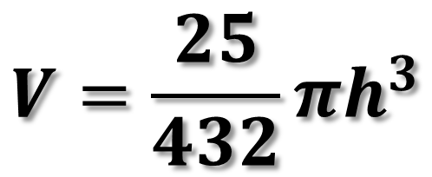






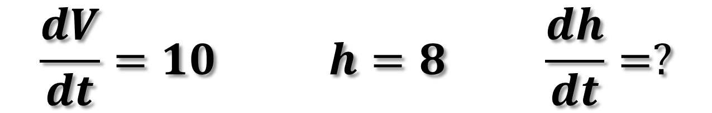





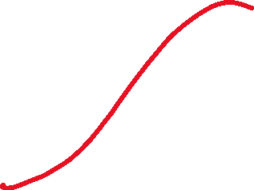




$$V=\frac{25}{432}πh^{3}$$
$$\frac{dV}{dt}=10 h=8 \frac{dh}{dt}=?$$

